Slide 2
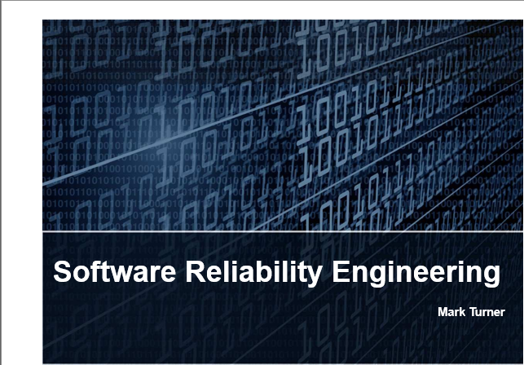
Software Reliability Engineering
Mark Turner

Slide 3

Different Views of Reliability
Product development teams
View reliability at the sub-domain level, addressing mechanical, electronic and software issues.
Customers
View reliability at the system level, with minimal consideration placed on sub-domain distinction.
The primary measure of reliability is defined by the customer.
To develop a reliable product engineering teams must consider both views (system and sub-domain).
System
Mechanical Reliability
+
Electronic Reliability
+
Software Reliability

Slide 4
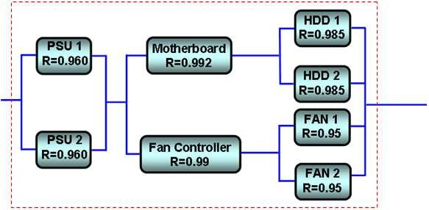




System-Level Reliability Modeling (1 of 2)
A system is made up of components/sub-systems; each has its own inherent reliability.
Software R=0.99
Computer Server R=0.9665
A “traditional” reliability program may include modeling, evaluation and testing to prove that the hardware meets the reliability target, but software should not be forgotten as it is a system component.
Individually the hardware and software may meet the reliability target…but they also have to when they are combined.
System probability of failure = H/W Failure Probability x S/W Failure Probability I.e., H/W = 0.9665, S/W = 0.99, System = 0.9665 x 0.99 = 0.9568
System Reliability = 95.68%

Slide 5
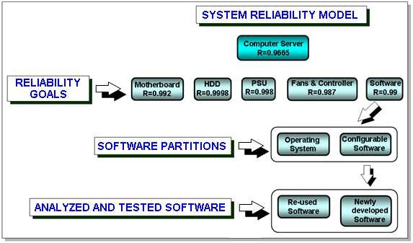


System-Level Reliability Modeling (2 of 2)
Therefore the software reliability should also be accounted for in the system-level reliability model.
Software may consist of both the operating system (OS) and configurable (turnkey) software. It may not be possible to influence the OS design, but turnkey software can be focused on.
This may consist of re-used software such as library functions and newly developed software.
If the reliability of the library functions is already understood then library function re-use simplifies the software reliability engineering process.

Slide 6
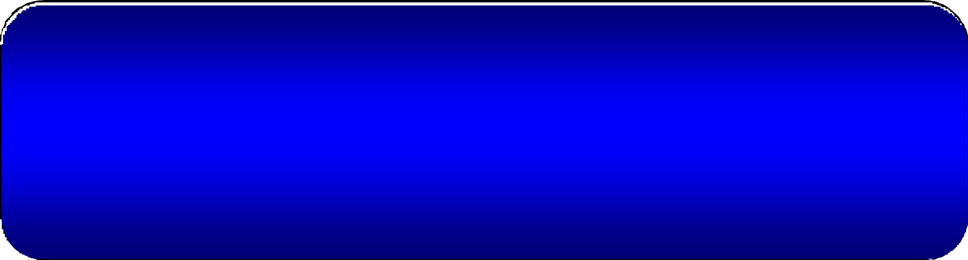
What is Software Reliability Engineering (SRE)?
The quantitative study of the operational behavior of software-based systems with respect to user requirements concerning reliability.

Slide 7




Why is SRE Important?
There are several key reasons a reliability engineering program should be implemented:
So that it can be determined how satisfactorily products are functioning.
Avoid over-designing – products could cost more than necessary and lower profit.
If more features are added to meet customer demand then reliability should be monitored to ensure that defects are not designed in, which could impact reliability.
If a customer’s product is not designed well, with reliability and quality in mind, then they may well turn to a COMPETITOR!
Having a software reliability engineering process can make organizations more competitive as customers will always expect reliable software that is better and cheaper.

Slide 8






Why is SRE Beneficial?
For Engineers:
Managing customer demands:
Enables software to be produced that is more reliable; built faster and cheaper.
Makes engineers more successful in meeting customer demands.
In turn this avoids conflicts – risk, pressure, schedule, functionality, cost etc.
For the organization: Improves competitiveness.
Reduces development costs.
Provides customers with quantitative reliability metrics.
Places less emphasis on tools and a greater emphasis on “designing in reliability.”
Products can be developed that are delivered to the customer at the right time, at an acceptable cost, and with satisfactory reliability.

Slide 9

Common SRE Challenges
Data is collected during test phases, so if problems are discovered it is too late for fundamental design changes to be made.
Failure data collected during in-house testing may be limited, and may not represent failures that would be uncovered in the product’s actual operational environment.
Reliability metrics obtained from restricted testing data may result in reliability metrics being inaccurate.
There are many possible models that can be used to predict the reliability of the software, which can be very confusing.
Even if the correct model is selected there may be no way of validating it due to having insufficient field data.

Slide 10



Fault Lifecycle Techniques
Prevent faults from being inserted.
Avoids faults being designed into the software when it is being constructed.
Remove faults that have been inserted.
Detect and eliminate faults that have been inserted through inspection and test.
Design the software so that it is fault tolerant.
Provide redundant services so that the software continues to work even though faults have occurred or are occurring.
Forecast faults and/or failures.
Evaluate the code and estimate how many faults are present and the occurrences and consequences of software failures.

Slide 11





Preventing Faults From Being Inserted
Initial approach for reliable software
A fault that is never created does not cost anything to fix. This should be the ultimate objective of software engineering.
This requires:
A formal requirement specification always being available that has been thoroughly reviewed and agreed to.
Formal inspection and test methods being implemented and used.
Early interaction with end-users (field trials) and requirement refinement if necessary. The correct analysis tools and disciplined tool use.
Formal programming principles and environments that are enforced. Systematic techniques for software reuse.
Formal software engineering processes and tools, if applied successfully, can be very effective in preventing faults (but is no guarantee!) However, software reuse without proper verification can result in disappointment.

Slide 12





Removing Faults
When faults are injected into the software, the next method that can be used is fault removal.
Approaches:
Software inspection. Software testing.
Both have become standard industry practices. This presentation will focus closely on these.

Slide 13





Fault Tolerance
This is a survival attribute – the software has to continue to work even though a failure has occurred.
Fault tolerance techniques enables a system to:
Prevent dormant software faults from becoming active (i.e., defensive programming to check for input and output conditions and forbid illegal operations).
Contain software errors within a confined boundary to prevent them from propagating further (i.e., exception handling routines to treat unsuccessful operations).
Recover software operations from erroneous conditions by using techniques such as check pointing and rollback.

Slide 14



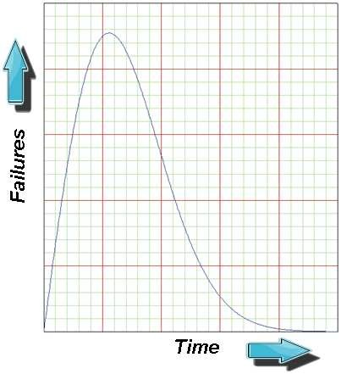



Fault/Failure Forecasting
If software failures are likely to occur it is critical to estimate the number of failures and predict when each is likely to occur.
This will help concentrate on failures that have the greatest probability of occurring, provide reliability improvement opportunities and improve customer satisfaction.
Fault/failure forecasting requires:
Defining a fault/failure relationship – why the failure occurs and its effect. Establishing a software reliability model.
Developing procedures for measuring software reliability. Analyzing and evaluating the measurement results.
Measuring software reliability provides:
Useful metrics that can be used to plan further testing and debug efforts, to calculate warranty costs and plan further software releases.
Determines when testing can be terminated.

Slide 15






SRE Process Overview
This slide shows a general SRE process flow that has six major components:
Determine Reliability Objective
Define Operational Profile
Determine Reliability
Objective
Define Operational
Profile
Perform Code Inspection
Perform Code Inspection
Determine the reliability Target.
Perform Software Testing
Perform Software Testing
Define a software operational Profile.
Continue Testing
Collect Failure Data
Select Appropriate Software Model
Conduct code inspection.
Select Appropriate Software
Model
Perform software testing.
Use software Reliability Model(s) to Calculate Current Reliability
Use software Reliability Model(s)
to Calculate Current Reliability
Conduct reliability modelling to measure the software reliability – continuously improve the software reliability until the target is reached.
Reliability Objectives met?
Software Release Acceptable from Reliability Perspective
Field reliability validation.
Validate Field Reliability
Validate Field Reliability

Slide 16





SRE Terms
Reliability objective: The product’s reliability goal from the customer’s viewpoint.
Operational profile: A set of system operational scenarios with their associated probability of occurrence.
This encourages testers to select test cases according to the system’s likely operational usage.
Reliability modeling: This is an essential element of SRE that determines whether the product meets its reliability objective.
One or more models can be used to calculate, from failure data collected during system testing, various estimates of a product’s reliability as a function of test time. It can also provide the following information:
Product reliability at the end of various test phases.
Amount of additional test time required to reach the product’s reliability objective. The reliability growth that is still required (ratio of initial to target reliability).
Prediction of field reliability.
Field Reliability Validation: Determination of whether the actual field reliability meets the customer’s target.

Slide 17






Software Reliability Objectives
Reliability target(s) should be defined and used to:
Manage customer expectations.
Determine how reliability growth can and will be tracked throughout the program.
Determine availability targets. Software reliability is commonly expressed as an availability metric though rather than as a probabilistic reliability metric. This is defined as:
Software uptime
Availability =
Software uptime + downtime
A data collection and analysis methodology also has to be defined:
How inspections will be conducted. How failure data will be collected.
How the data will be analyzed, i.e., what model will be used? This helps project managers track metrics and plan resource.

Slide 18





Software Availability and Failure Intensity (1 of 2)
As mentioned earlier, instead of a reliability metric being provided, customers may ask for a certain ‘availability’.
This is the average (over time) probability that a system or a capability of a system is currently functional in a specified environment.
It depends on:
The probability of software failure Length of downtime when failure occurs.
It essentially describes the expected fraction of the operating time during which a software component or system is functioning acceptably.
If the software is not being modified (if further development or further releases are not planned) then the failure rate will be constant and therefore the availability will be constant.

Slide 19





Software Availability and Failure
Intensity (2 of 2)
From earlier, availability is defined as: Availability =
Software uptime
Software uptime + downtime
Downtime can be expressed as:
Downtime = t_{m} λ
Where: t_{m}=downtime per failure
λ=failure intensity
For software , the downtime per failure is the time to recover from the failure, not the time required to find and remove the fault.
1
1+ t_{m}λ
∴ Availabilty =
If an availability specification for the software is specified, then the downtime per failure will determine a failure intensity objective:
_{λ =} 1− Availability Availability × t_{m}
Either an availability or a failure intensity objective have to be defined.

Slide 20

Example
A product must be available 99% of time. Required Downtime = 6 minutes (0.1hr)
The downtime per failure can be used to determine the failure intensity objective.
_{λ =} 1− A
At_{m}
_{∴ λ =} 1− 0.99
0.99 × 0.1
∴ λ = 0.1 failure / hr
or 100 failures/kHrs

Slide 21




Availability, Failure Intensity, Reliability and MTBF
This presentation will discuss reliability in terms of availability, probability and MTBF. These are the relationships between each of these three metrics.
A customer specifies an availability target of 0.99999 and a maximum software downtime of 5 minutes, or 0.083 hours. The failure intensity is determined from:
λ =
Downtime ₌ 0.00083
= 0.083 failures / Hr
Availability 0.0099999
What is the reliability probability for a period of 2 years?
₋ λT ₋ 0.99999×17520 _{=0.99998}
R(t) = e = e
1×10⁹ 1×10⁹
What is the Mean Time Between Failures (MTBF)?
MTBF =
1×10⁹ 1×10⁹
10
λ
= = 1.2 ×10 0.083
Hours

